Slide 1
תכנות מונחה עצמים תרגול 2
מייל: Lashover.ariel@gmail.com
נכתב ע"י: איתי לשובר

Slide 2
נושאים להיום:
טיפול בשגיאות וחריגים
טיפול בקבצים
Json

Slide 3
Exceptions
When executing Java code, different errors can occur: coding errors made by the programmer, errors due to wrong input, or other unforeseeable things.
When an error occurs, Java will normally stop and generate an error message. The technical term for this is: Java will throw an exception (throw an error).

Slide 5
try-catch block
try block
Java try block is used to enclose the code that might throw an exception. It must be used within the method.
If an exception occurs at the particular statement in the try block, the rest of the block code will not execute. So, it is recommended not to keep the code in try block that will not throw an exception.
Java try block must be followed by either catch or finally block.
catch block
Java catch block is used to handle the Exception by declaring the type of exception within the parameter. The declared exception must be the parent class exception ( i.e., Exception) or the generated exception type. However, the good approach is to declare the generated type of exception.

Slide 6
Internal Working of Java try-catch block

Slide 7
Internal Working of Java try-catch block
Solution by exception handling
Problem without exception handling

Slide 8
finally block
finally block is a block used to execute important code such as closing the connection, etc.
Java finally block is always executed whether an exception is handled or not. Therefore, it contains all the necessary statements that need to be printed regardless of the exception occurs or not.
The finally block follows the try-catch block.
Why use Java finally block?
finally block in Java can be used to put "cleanup" code such as closing a file, closing connection, etc.
The important statements to be printed can be placed in the finally block.

Slide 10
Java throw keyword
The Java throw keyword is used to throw an exception explicitly.
We specify the exception object which is to be thrown.
The Exception has some message with it that provides the error description. These exceptions may be related to user inputs, server, etc.
We can throw either checked or unchecked exceptions in Java by throw keyword.
It is mainly used to throw a custom exception.
We will discuss custom exceptions later in this section.
We can also define our own set of conditions and throw an exception explicitly using throw keyword. For example, we can throw ArithmeticException if we divide a number by another number. Here, we just need to set the condition and throw exception using throw keyword.

Slide 11
Java throw keyword

Slide 12
Java throw keyword

Slide 13
Java throws keyword
The Java throws keyword is used to declare an exception.
It gives an information to the programmer that there may occur an exception.
So, it is better for the programmer to provide the exception handling code so that the normal flow of the program can be maintained.
Exception Handling is mainly used to handle the checked exceptions.
If there occurs any unchecked exception such as NullPointerException, it is programmers' fault that he is not checking the code before it being used.

Slide 14
throw VS throws

Slide 15
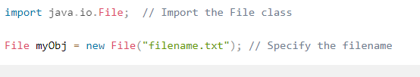
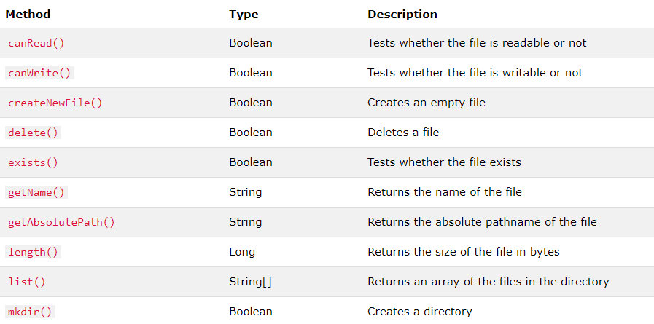
Java Files
The File class from the java.io package, allows us to work with files.
To use the File class, create an object of the class, and specify the filename or directory name:

Slide 16
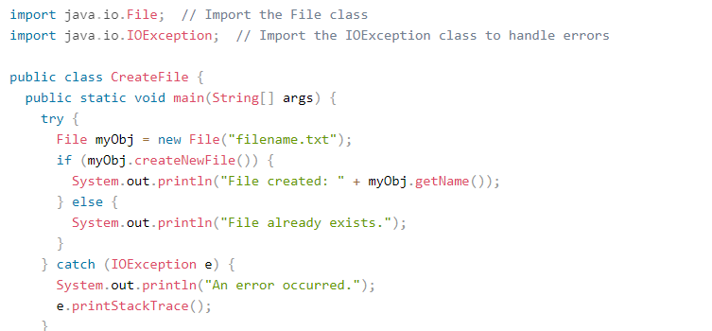
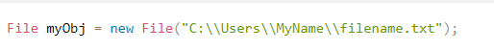
Create a File
To create a file in Java, you can use the createNewFile() method. This method returns a boolean value: true if the file was successfully created, and false if the file already exists.
Note that the method is enclosed in a try...catch block.
This is necessary because it throws an IOException if an error occurs (if the file cannot be created for some reason)
To create a file in a specific directory (requires permission), specify the path of the file and use double backslashes to escape the "\" character (for Windows). On Mac and Linux you can just write the path, like: /Users/name/filename.txt

Slide 17
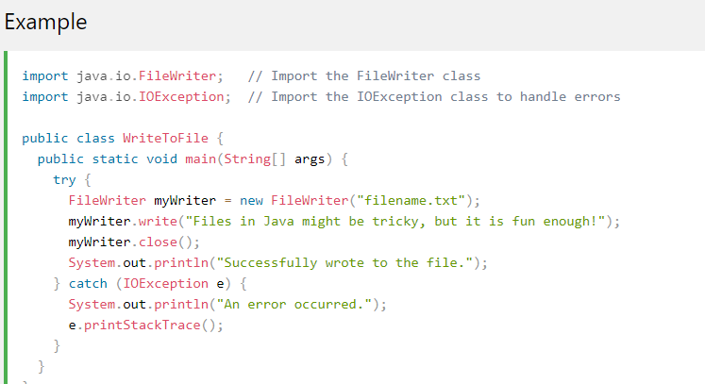
Write to a File
In the following example, we use the FileWriter class together with its write() method to write some text to the file we created in the example above.
Note that when you are done writing to the file, you should close it with the close() method:

Slide 18
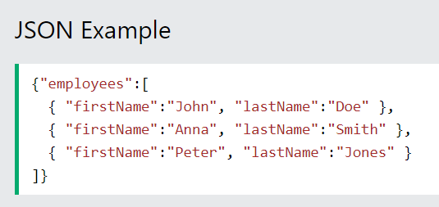
JSON
The following JSON example define an employees object, with an array of 3 employees:

Slide 19
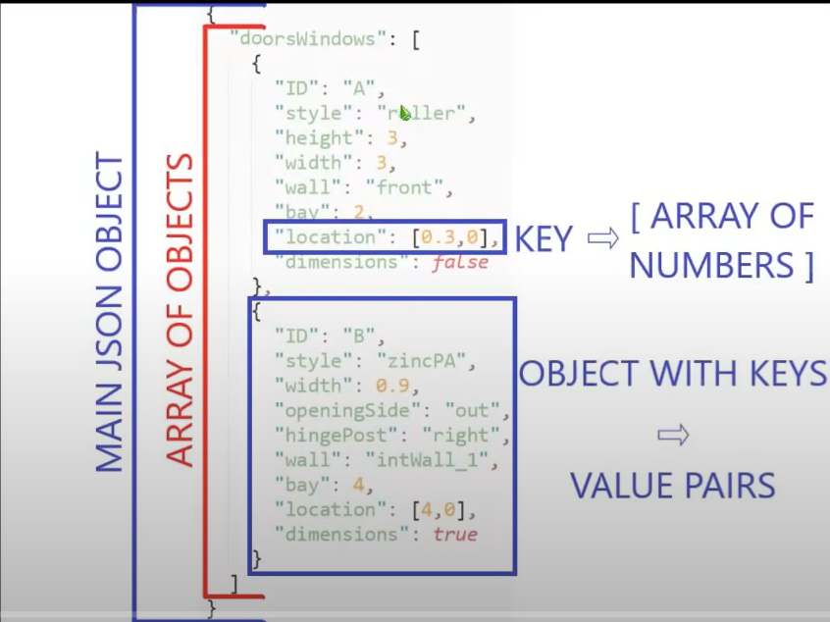
JSON Syntax rules
Data is name/value pairs
Data is separated by commas
Curly braces hold objects
Square brackets hold arrays

